Slide 1
How long is a piece of string?
Quantifiable aspects of Architecture Frameworks
Matthew Hause: PTC
Lars-Olof Kihlström: Syntell AB

Slide 2
Presenters
Matthew Hause: PTC
  GTM Solutions Specialist, Fellow at PTC
  Co-Chair UPDM Group at OMG
  Member of SysML development team
  OMG Architecture Board Member
  Consultant, trainer, mentor of MBSE and Enterprise Architecture
Lars-Olof Kihlström: Syntell AB
  Principal consultant at Syntell
  Member of the UPDM group since its inception
  Project manager for the MODAF re-engineering work that resulted in MODEM
  Member of the NAF revision syndicate (while it existed), responsible for NAF 3.0 and 3.1 on behalf of the Swedish Armed Forces
  Member of the IDEAS group (while it existed) on behalf of the Swedish Armed Forces
  Primarily engaged as mentor, coach and developer concerning model based system engineering and enterprise architecture
Notes:
Lars and Matthew

Slide 3
Quantifiable aspects of MBSE and enterprise architecture
Model-Based Systems Engineering (MBSE) means that communication of system requirements can be improved with models rather than relying on “just words”.
The Systems Modeling Language (SysML) was developed by INCOSE and the Object Management Group (OMG) to enable MBSE.
It supports the specification, analysis, design, verification and validation of a broad range of systems and systems-of-systems.
Systems engineers have been trying to get more out of their models by making them executable to answer questions or obtain results.
  The greatest concentration of work on executable models has concentrated on behavioral execution using code generation.
This can also be done in modeling languages based on UML such as SysML and versions of the Unified Profile for DoDAF and MODAF (UPDM).
Notes:
Matthew

Slide 4
Is behavioral aspects all that is important?
Behavioural aspects could be only a small part of the overall system requirements. Requirements can be non-functional, performance, structural, domain, cost, user interface, organizational, safety, interoperability and so forth.
  Rather than just considering models as execution of behavior, it is important to look at a model as a means of getting at quantitative and qualitative analysis results as well as behavioural ones.
In order to fully grasp how different types of elements operate in different scenarios, it is important to take a look at aspects of use, performance, cost etc. from an overall point of view.
Significant benefits can be realized by making use of architecture frameworks as a means of exploring these issues and tie the lessons learned from this into a direct MBSE development.
In order to fully make use of quantifiable aspects a clear appreciation of what is meant is required.
Notes:
Matthew

Slide 5

UPDM version 1
UML profile based
MODAF v1.2.003
NAF v3.0
1.1
DoDAF 1.5
There was a bit of SysML in MODAF and the implementation of UPDM could choose between a pure UML or UML and SysML approach.
UPDM contained both a profile as well as a domain meta-model that explained the meaning of the elements in the profile.
Notes:
Matthew

Slide 6
UPDM version 2
UML profile based
MODAF v1.2.004
NAF v3.1
2.1
IDEAS based
DoDAF 2.02
There was still a bit of SysML in MODAF and the implementation of UPDM could choose between a pure UML or UML and SysML approach.
UPDM contained both a profile as well as a domain meta-model that explained the meaning of the elements in the profile.
Notes:
Lars

Slide 7

UPDM version 3
UML profile based
MODAF v1.2.004
IDEAS based
MODEM
DMM
3.0
NAF v4.0
DoDAF 2.02
change 1
DNDAF
Other influences…
Notes:
Lars

Slide 8
Framework developments
UPDM RFP requirement: ” The UPDM V3.0 domain metamodel shall be derived from MODEM and DM2, both of which are based upon the International Defence Enterprise Architecture Specification Foundation [IDEAS].”
    Mandatory requirements (excerpt):
      Provide Domain Metamodel (Abstract Syntax and Constraints) derived from MODEM and DM2
      An Architecture Framework Profile Using SysML
      Enable the Expression Of Business Process Models
      Use of SysML Requirements Elements and Diagrams
      Use of SysML Parametrics Elements and Diagrams Mapped to Measurements
      Traceability Matrix to Supported Frameworks
    Non mandatory features (excerpt):
      UML Profile for NIEM
      Information Exchange Packaging Policy Vocabulary (IEPPV)
      Viewpoints in Support of SoS Life Cycle Processes and Analyses
      Support for Additional Viewpoints beyond those defined in DoDAF, MODAF/ MODEM, NAF, and the Security Viewpoint from DNDAF.
      Human Systems Integration (HSI)
Notes:
Lars

Slide 9
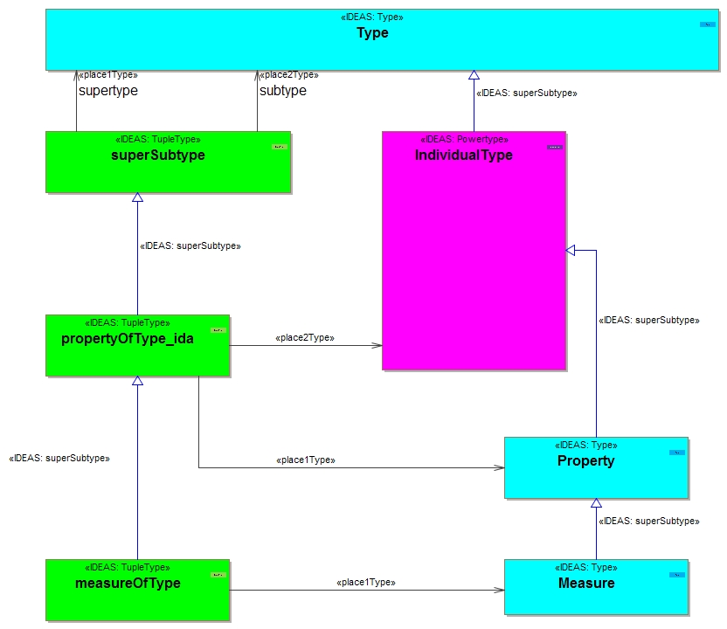
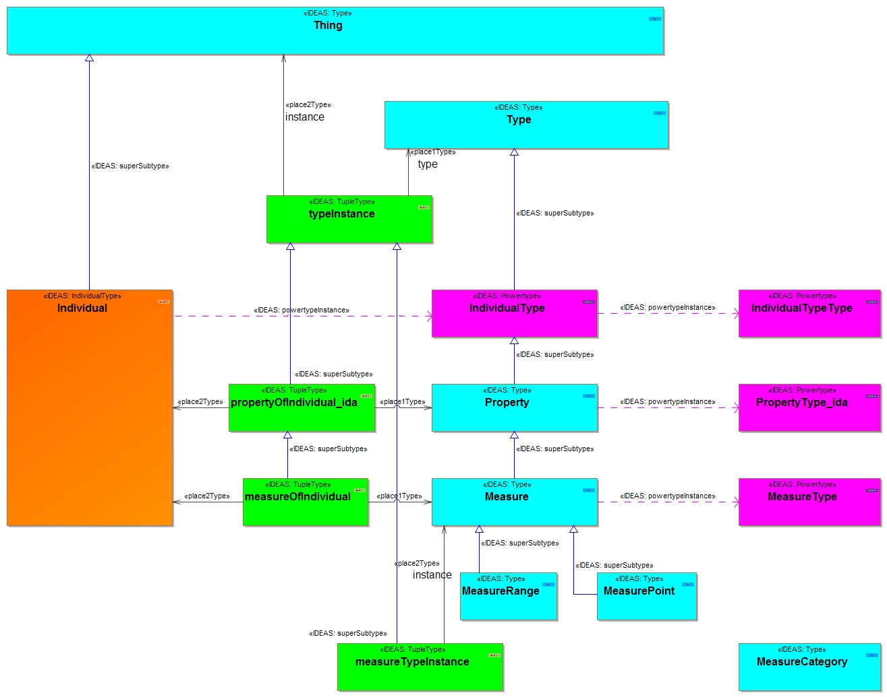
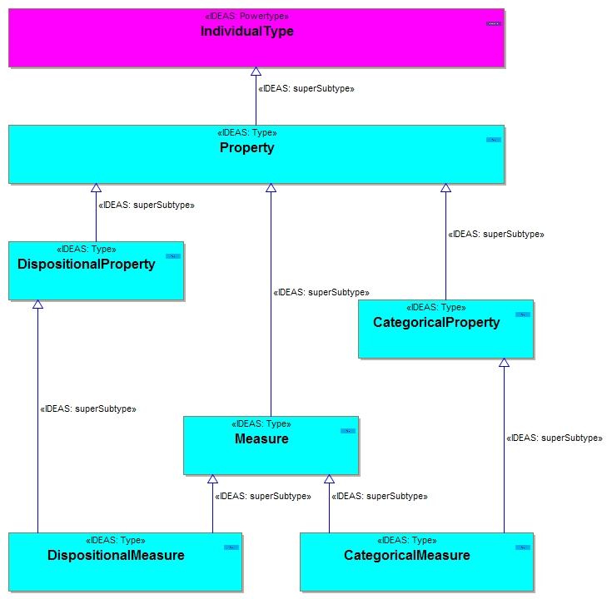
Quantifiable aspects?
IDEAS and MODEM is based on the mathematical concept of sets.
Notes:
Lars

Slide 10

An example of a categorical property and measure
Notes:
Lars

Slide 11
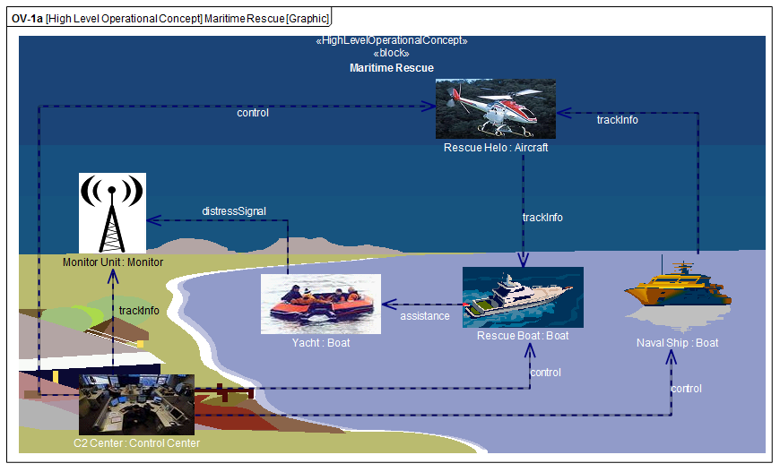
The SAR distress scenario
Notes:
Matthew

Slide 12
E3 Capability Dependencies (CV-4/ StV-4)
Required Capability
Owning Capability
Capability dependencies provide context for capability phases and resource deployment
Capability Dependency
Notes:
12
Matthew

Slide 13
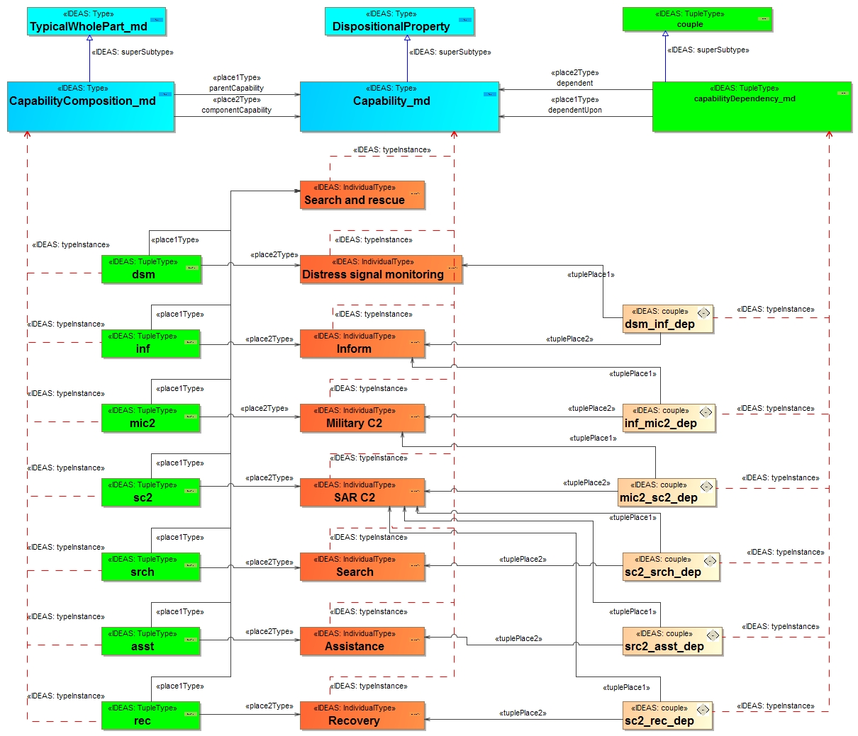
MODEM Capability Dependencies
Notes:
Lars

Slide 14
Lp Actual Project (PV-2/ AcV-2)
Actual Project
Actual Milestone
Definition of projects, sub-projects, milestones and dependencies
Milestone Dependency
Notes:
14
Matthew

Slide 15
Lp Project Detail (PV-2/ AcV-2)
Resource
Project
Resource Used By
Organization/ Person Responsible
Theme Statuses
Milestone
Notes:
15
Lars

Slide 16
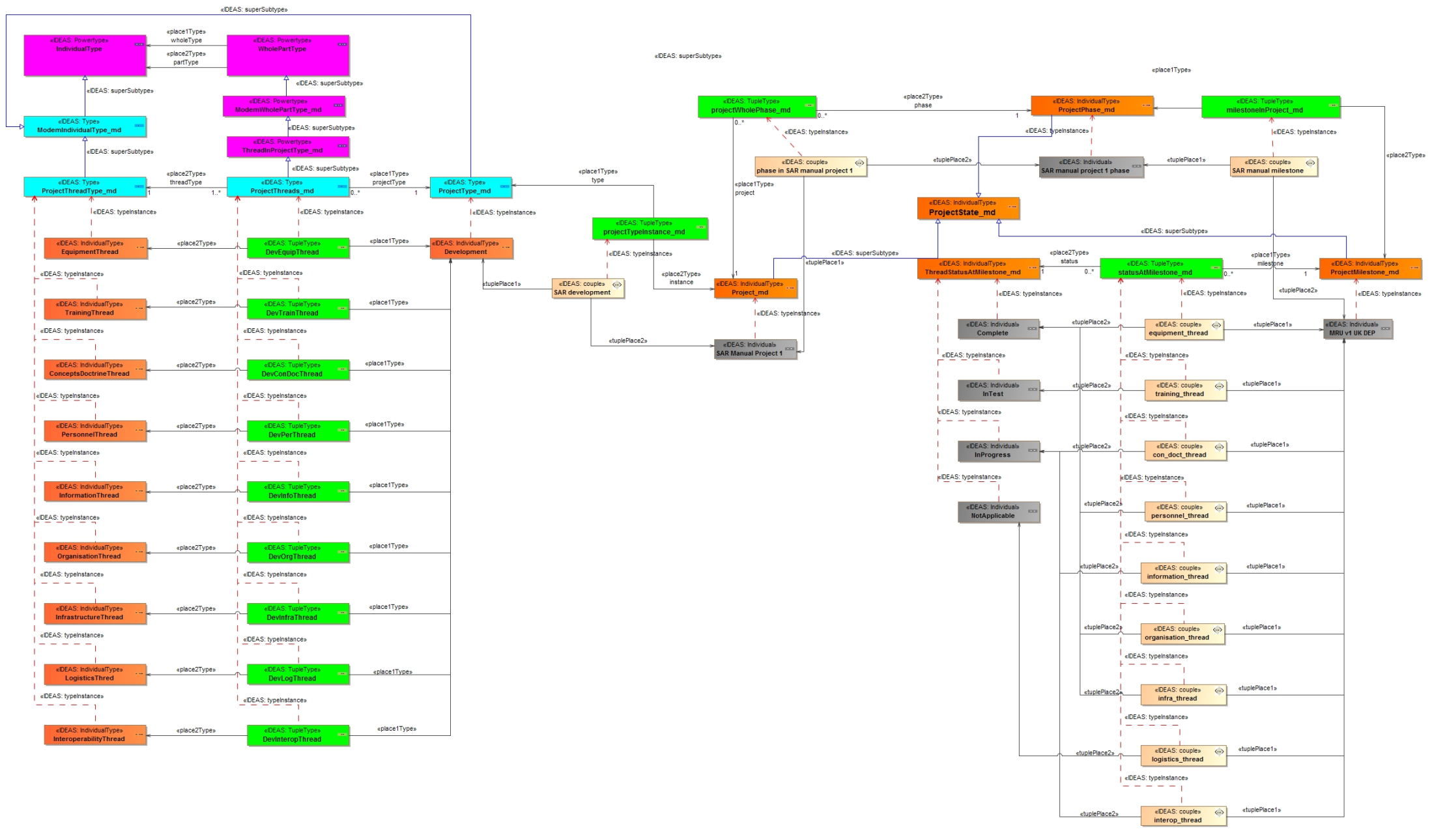
Lp Themes
Notes:
16
Lars

Slide 17
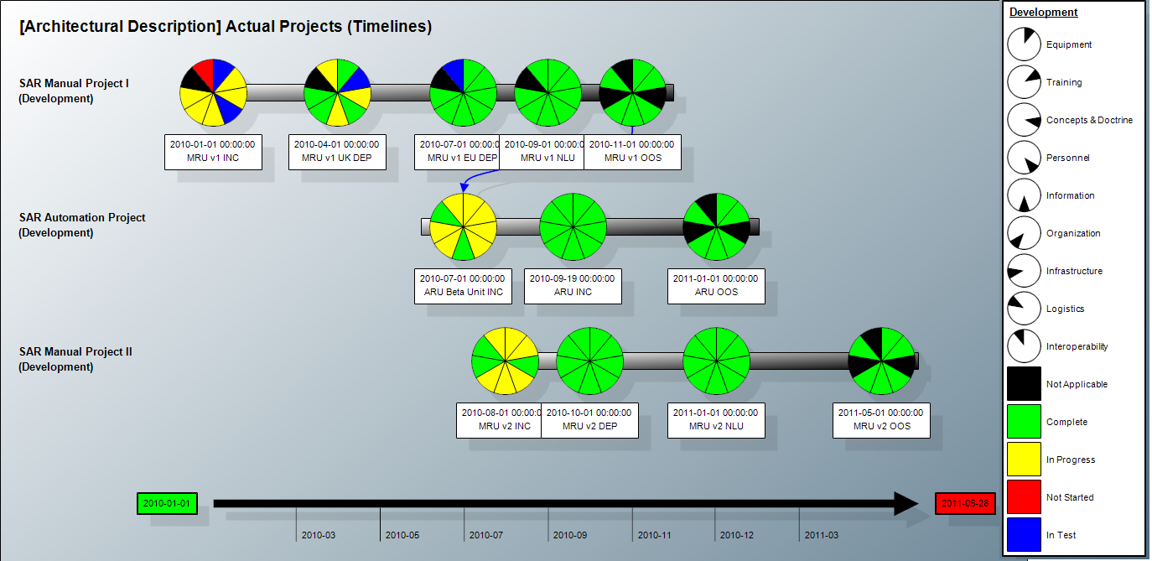
Lp Project Timelines
Project Timeline
Milestone Dependency
Milestone
Dashboard view provides project status at a glance: generated from model
Notes:
17
Matthew

Slide 18
AV-3 Measurements Definitions
Measurement Set
Measurements
Definition of metrics for reuse throughout the architecture.
Measurement Sub-Type
Notes:
18

Slide 19
AV-3 Actual Measurements
Specific metric values
Actual Measurement
Measurement Values
Notes:
19

Slide 20
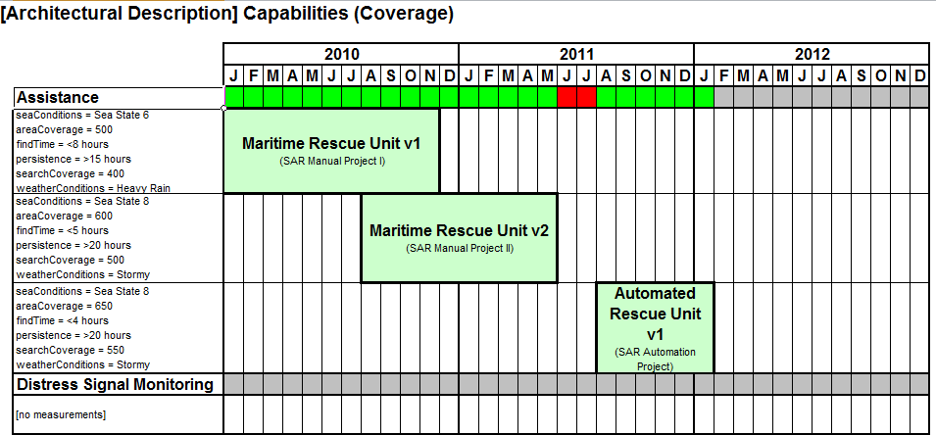
Ep Capability Phasing (Fragment) (CV-3/ StV-3)
Timeline
Capability Gap
Capabilities
Summarizes how and when capabilities will be realized as well as metrics. Identifies capability gaps.
Coverage
Capability Metrics
Realizing Resource
Notes:
20
Matthew

Slide 21
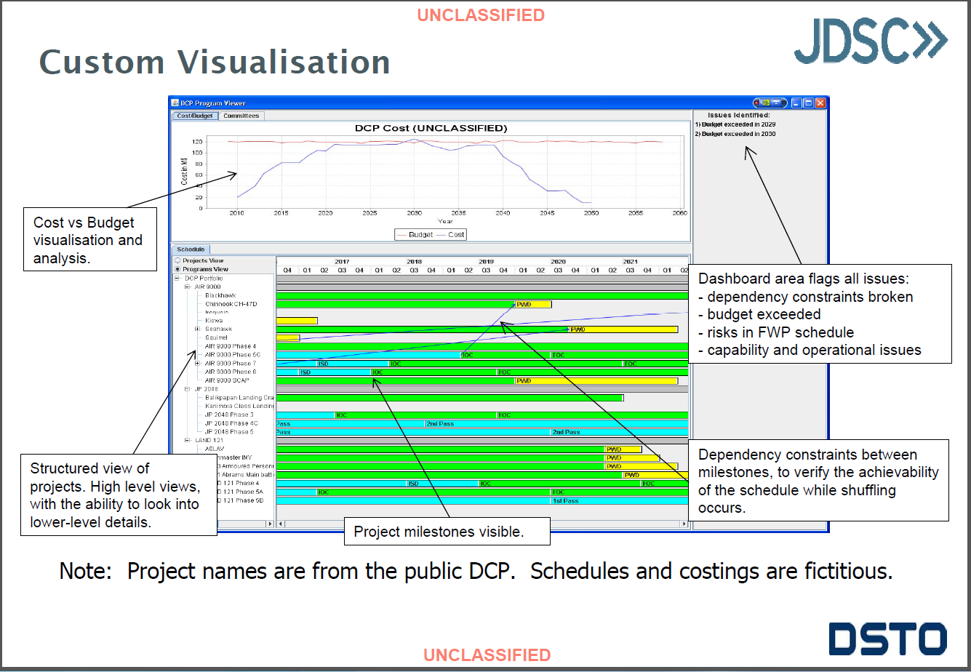
Showing cost vs. time vs. capability (2)
Pres

Slide 22
System Configuration Trade-Off Analysis
Owned System
Subsystem
Value Properties
Notes:
22
Matthew

Slide 23
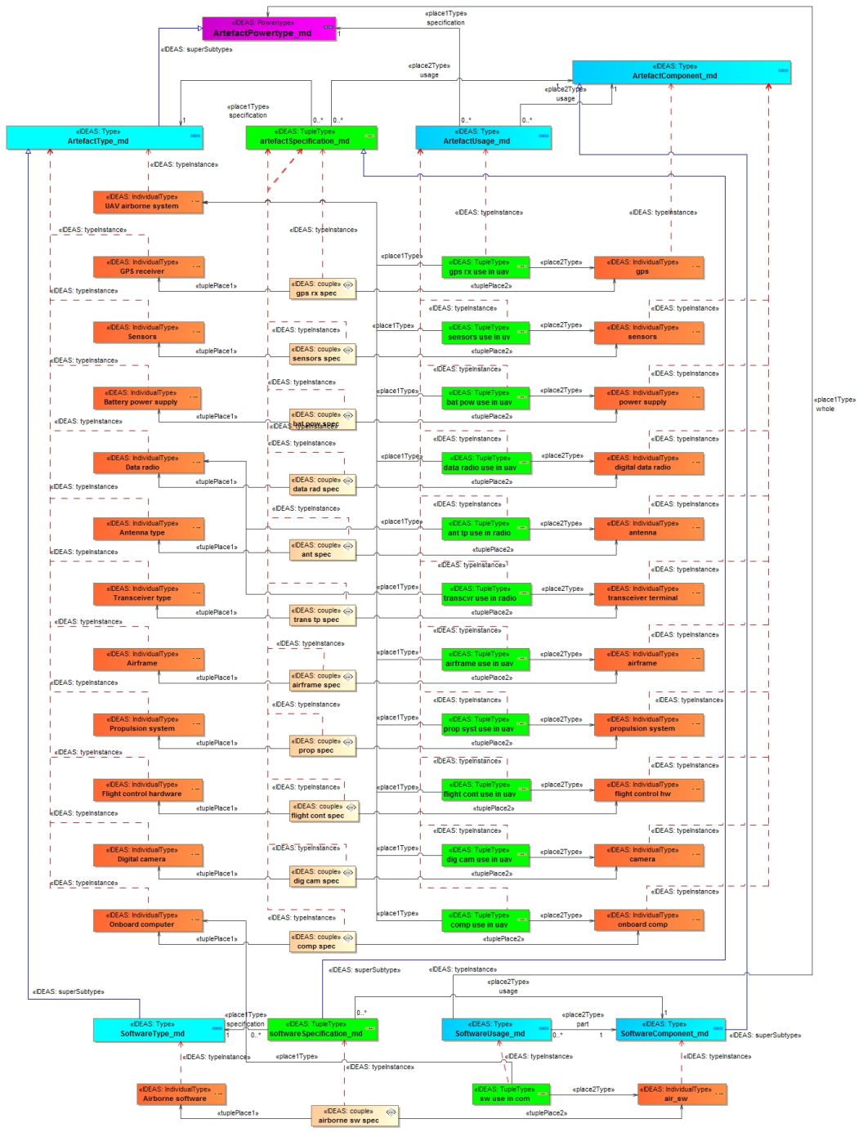
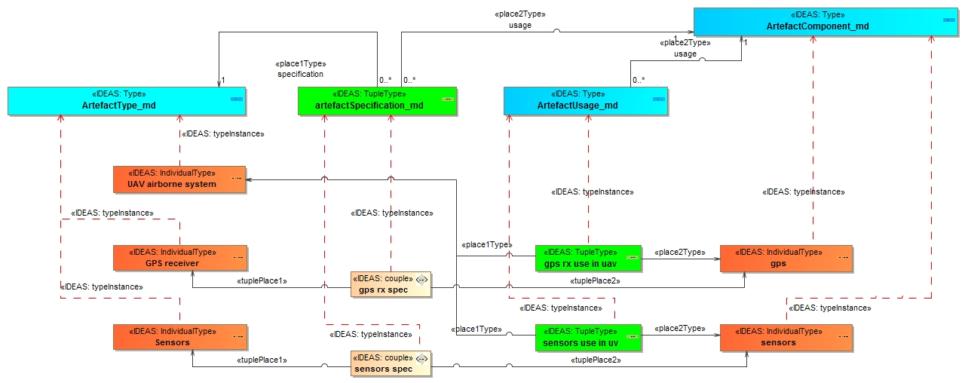
System configuration
Notes:
23
Lars

Slide 24
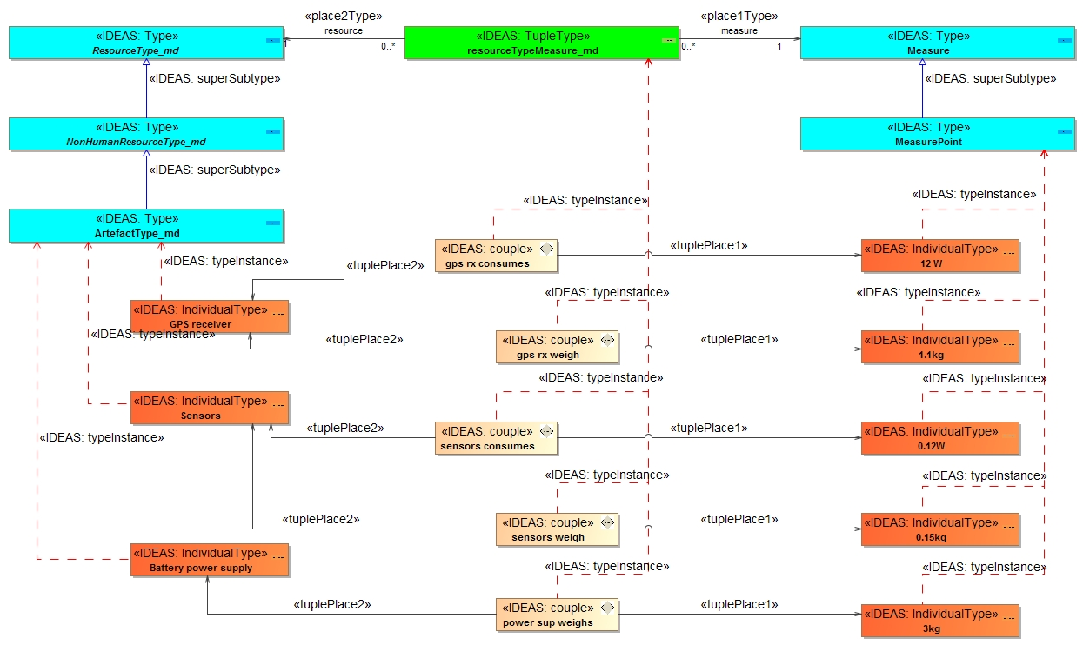
System configuration

Slide 25
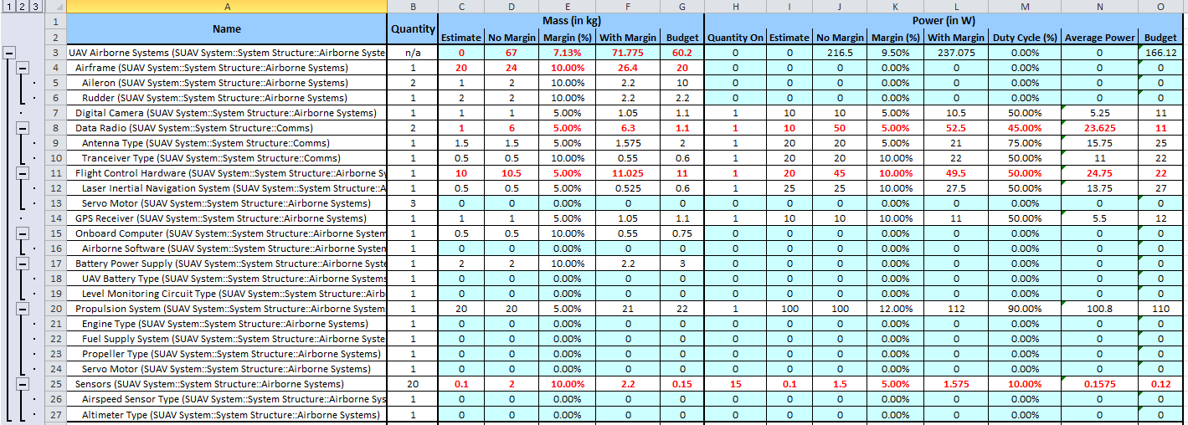
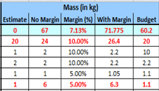
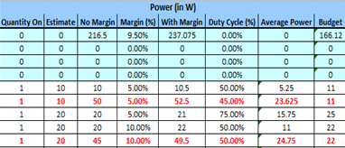
System Configuration Trade-Off Analysis
Notes:
Matthew

Slide 26
Parametrics – Trade-Off Analysis
Used to express constraints (equations) between value properties
  Provides support to engineering analysis
    e.g. performance, reliability, etc
Constraint block captures equations
  Expression language can be formal
    e.g. MathML, OCL …
  or informal
  Computational engine is defined by applicable analysis tool
    and not by SysML
Parametric diagram represents the usage of the constraints in an analysis context
  Binding of constraint usage to value properties of blocks
    e.g. vehicle mass bound to F= m * a
Notes:
Matthew

Slide 27
SysML Parametrics – Mean Response Time
Context
BDD for Mean Response Time Analysis
Command Center Values
Aircraft Values
Environmental Values
Boat and Yacht Values
Notes:
27
Matthew

Slide 28
SysML Parametrics
Context
Equation for calculating mean response times
Property of System
Value Property
Parameter
Parametric Equation
Notes:
28
Matthew

Slide 29
SysML Parametrics – Tradeoff Analysis
Initial values and ranges set by engineer.
Solution Values
Notes:
29
Matthew

Slide 30
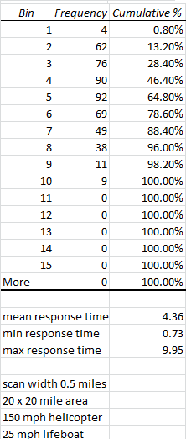
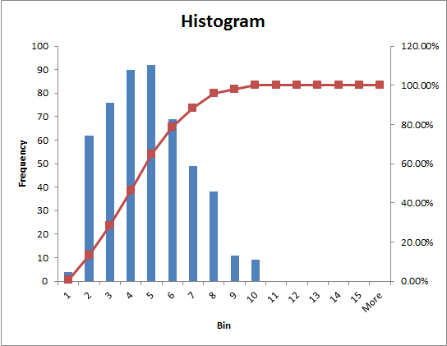
SysML Parametrics – Solution
Optimized solution provided by equation solver
Notes:
30
Matthew

Slide 31
L2 Operational Nodes (Performers) (OV-2)
Operational nodes with needlines and flows
Context
Node
Flow
Notes:
31
Matthew

Slide 32
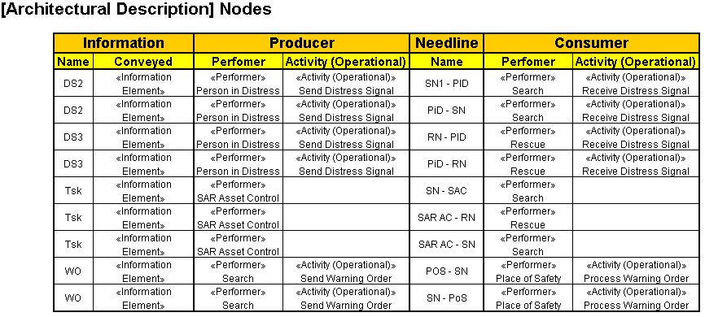
L3 Operational Resource Flow Matrix (Fragment) (OV-3)
Producing Performer OV-2
Consuming Performer OV-2
Overlap Type DIV-2
Overlap Ov-2
Producing Activity OV-5
Connection OV-2
Consuming Activity OV-5
Generated automatically from the architecture
Notes:
32
Matthew

Slide 33
Comms Metrics Definition and Instances

Slide 34
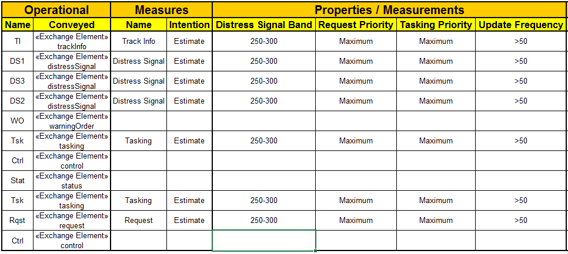
Messages with Added Metrics

Slide 35
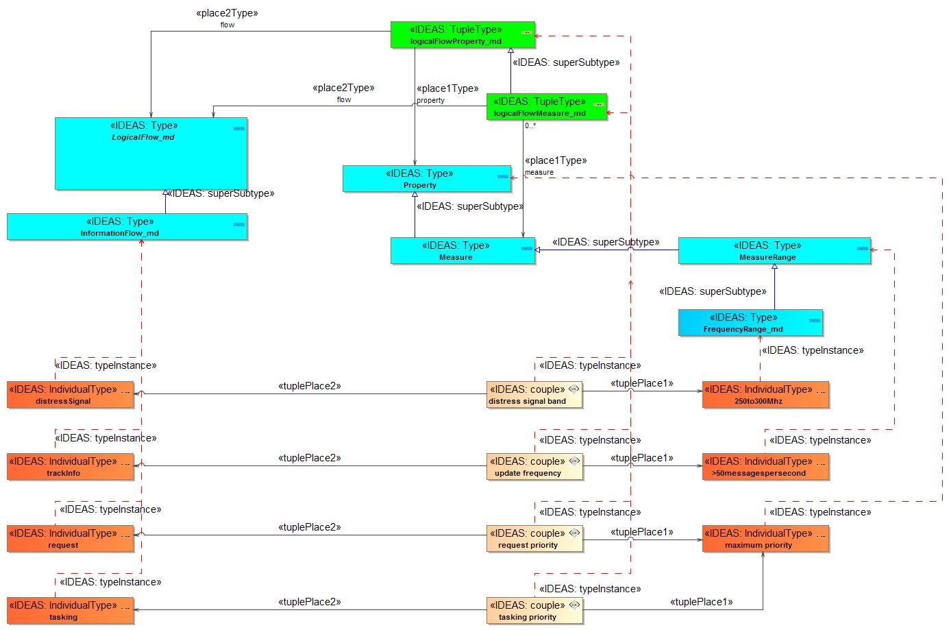
Metrics

Slide 36
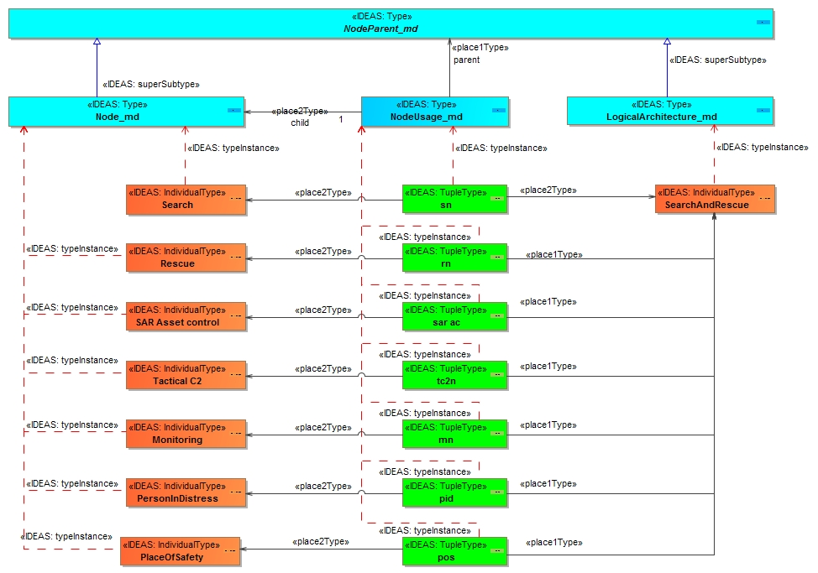
L2 Operational nodes
Notes:
36
Lars

Slide 37
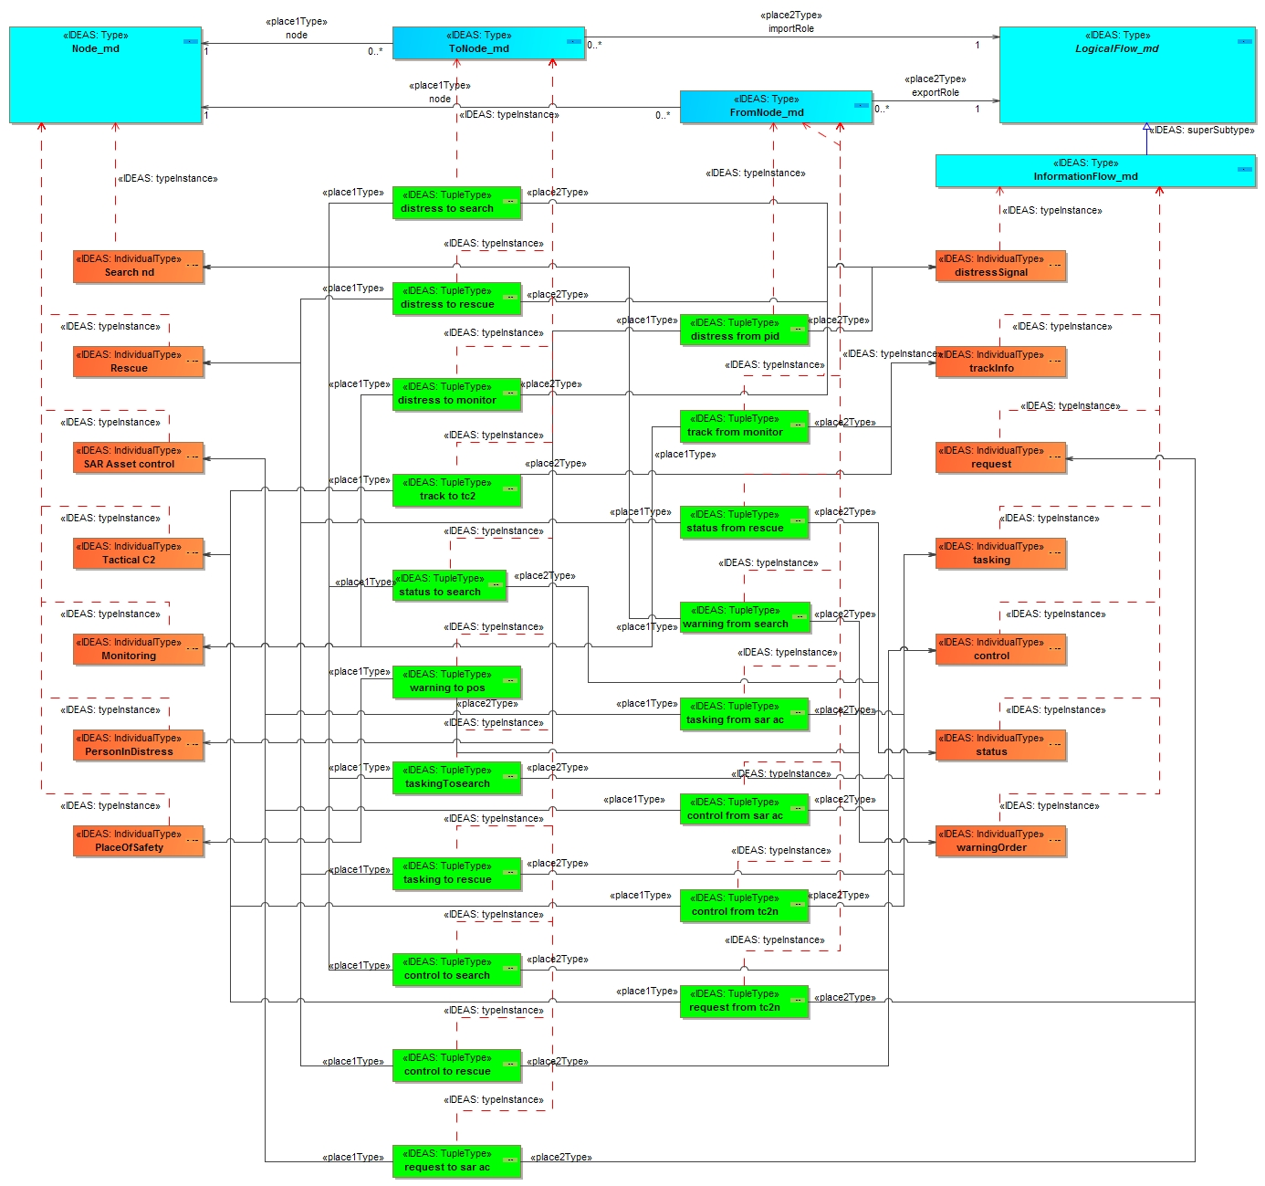
L2 Information flows
Notes:
37
Lars

Slide 38
Conclusions
The purpose of a model is to answer one or more questions
  Before you start, agree on the question
Assessment criteria should be agreed prior to starting the model
A well-documented process is essential for success
Executable architectures should look at more than just behavior.
Executing an architecture requires data
  (You can’t execute a PowerPoint slide.)
In order to ensure that the data is semantically correct a “wash” through an IDEAS based ontology is a good idea.
Notes:
Matthew and Lars

Slide 39

Questions, Comments, Discussion

